Slide 1
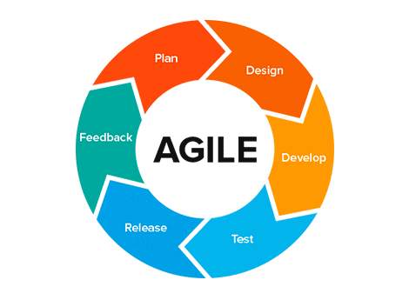
Agile: Software Development
Introduction
SoftUni Team
Technical Trainers
Software University
http://softuni.bg

Slide 2
Have a Question?
sli.do #Agile-2021

Slide 3
Table of Contents
An icebreaker.
Agile today.
Historical overview.
Different methodologies after WW2.
So, what is Agile?

Slide 4
What is Agile? - Brainstorm

Slide 5
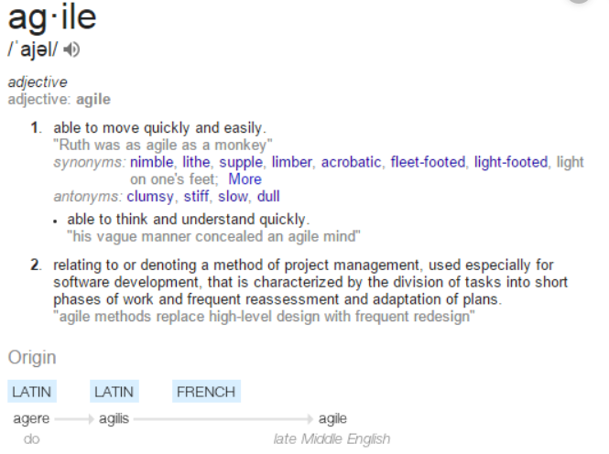
What is Agile?

Slide 6
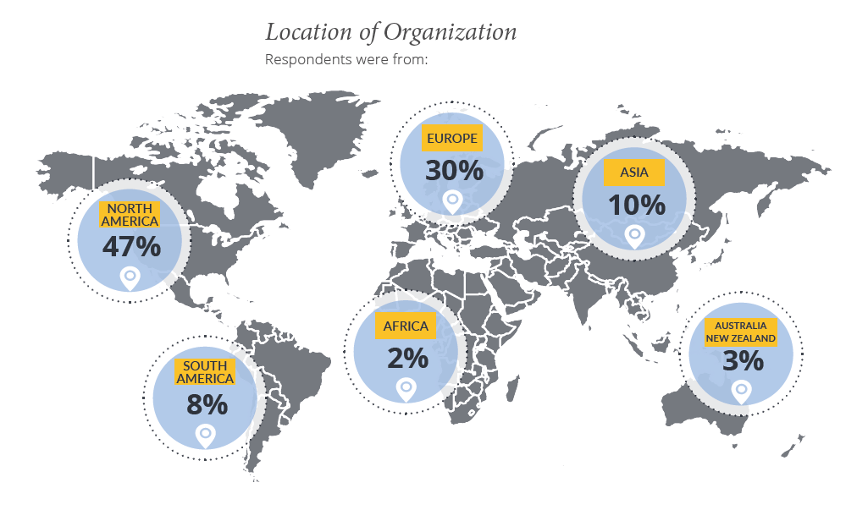
Agile Culture today

Slide 7
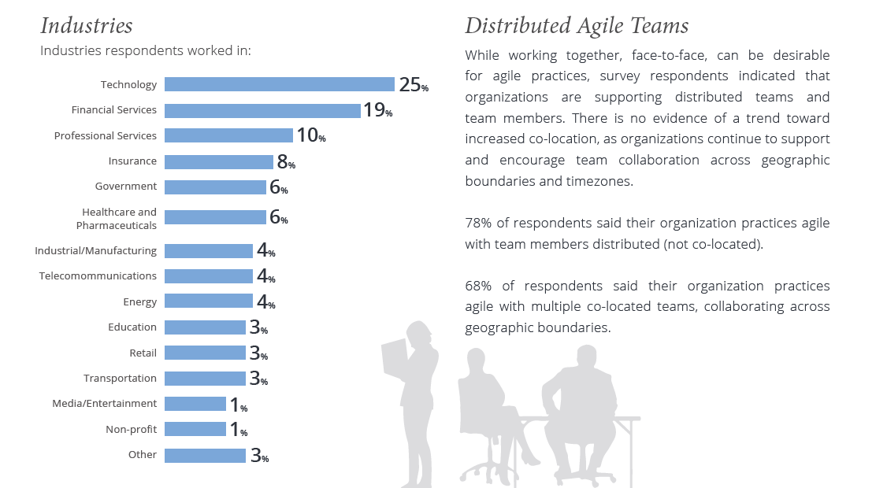
Agile Culture today

Slide 8
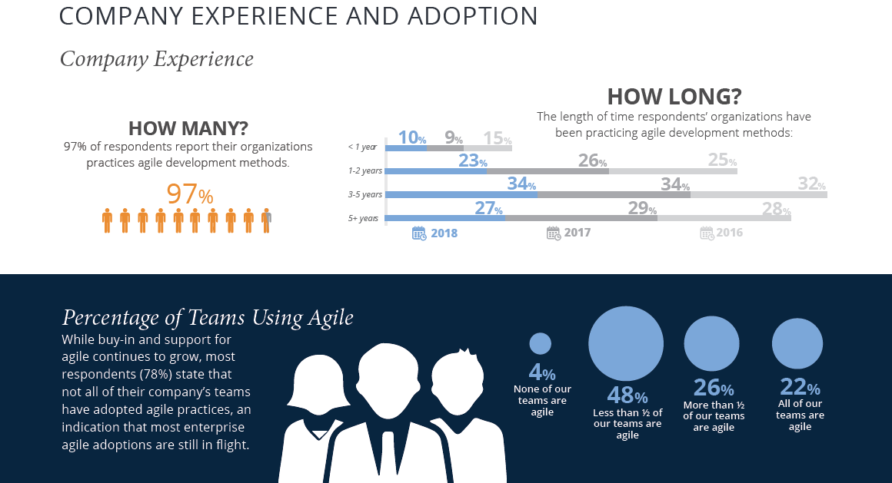
Agile Culture today

Slide 9
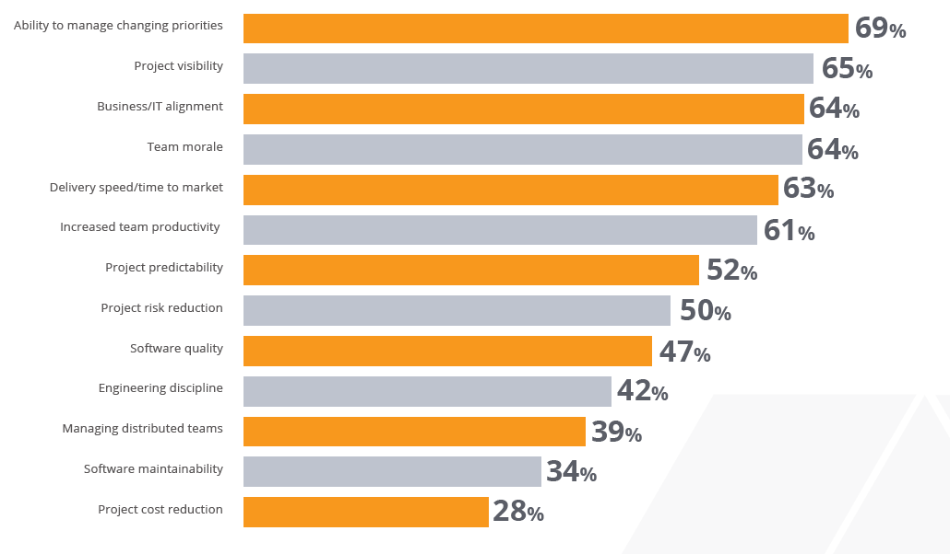
Agile Culture today

Slide 10
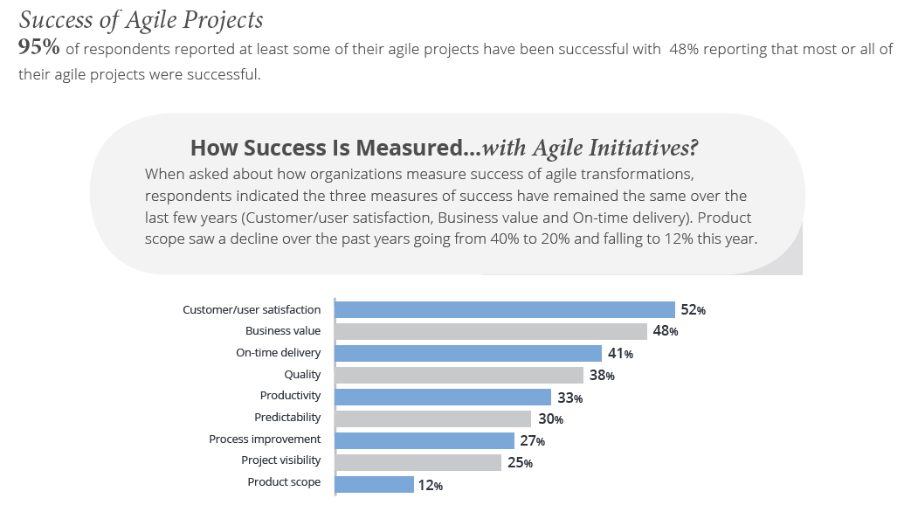
Agile Culture today

Slide 11
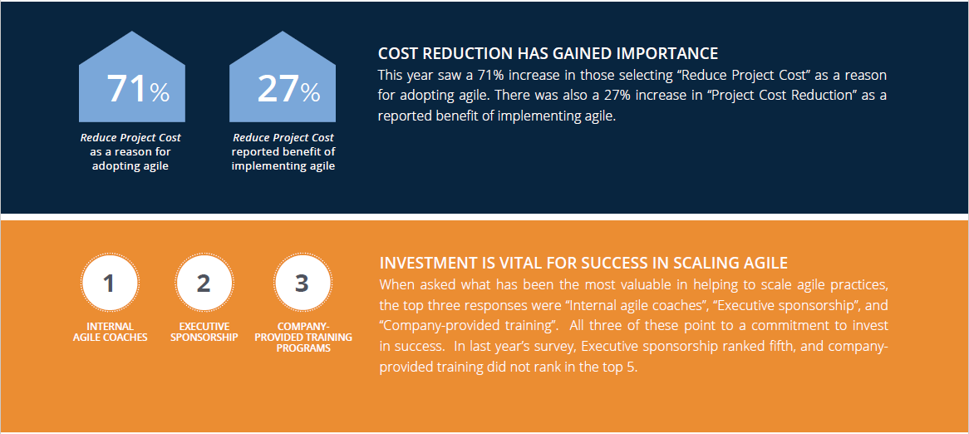
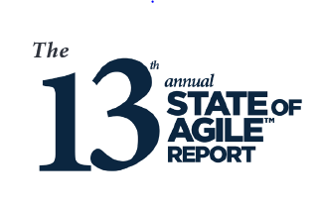
Agile Culture today

Slide 12
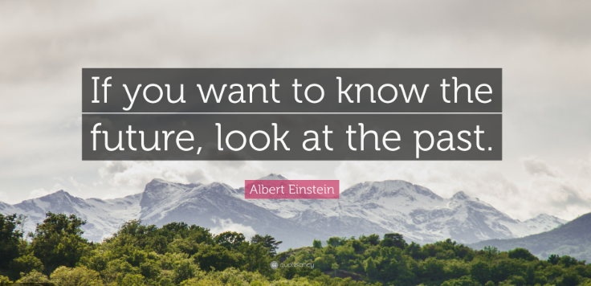

Slide 13

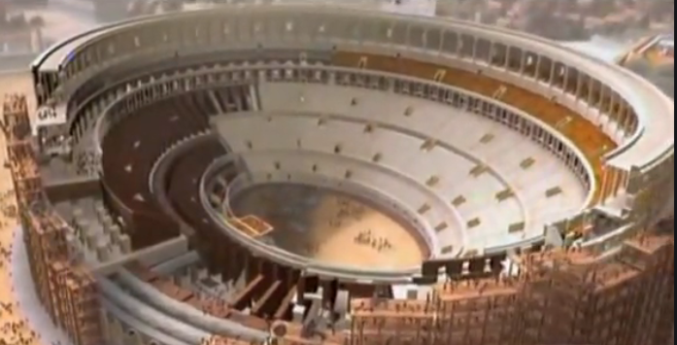
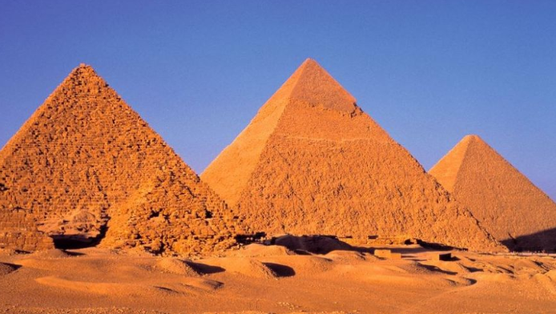

But how did it all begin…?

Slide 14
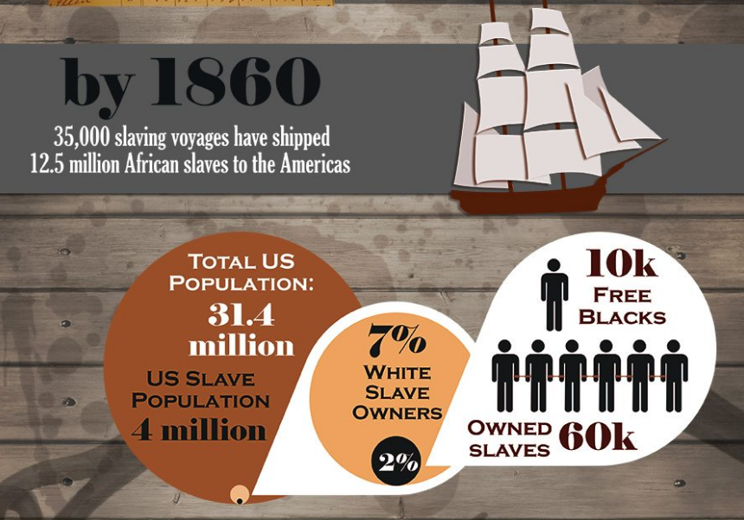
Slavery as commodity | Military standards | Autocratic Management Style

Slide 15
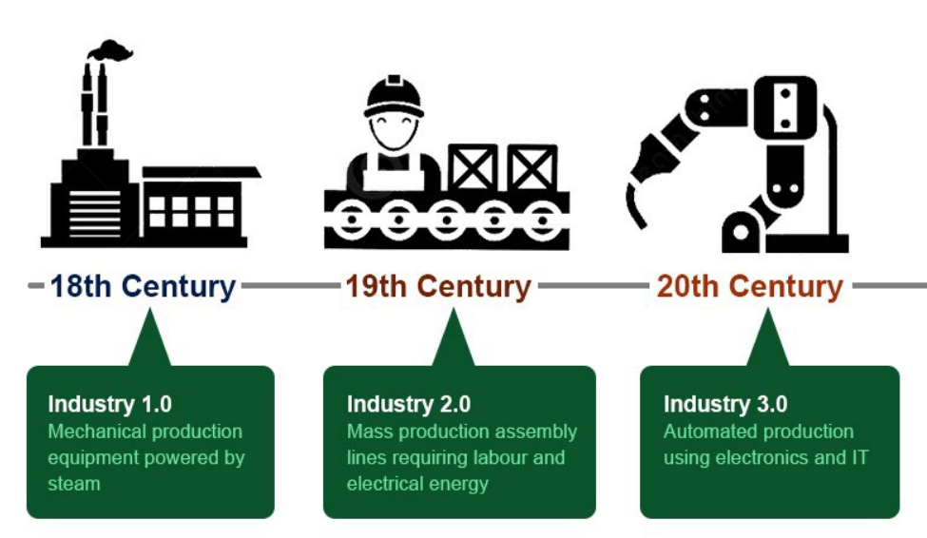
Industrial Revolutions
Notes:
A first (industrial) revolution was triggered by the construction of railroads and the invention of steam engines.
Energy, logistics and communication are behind the 2nd (specially electricity)
3rd revolution is characterized by automation, electronics and first step on IT.

Slide 16
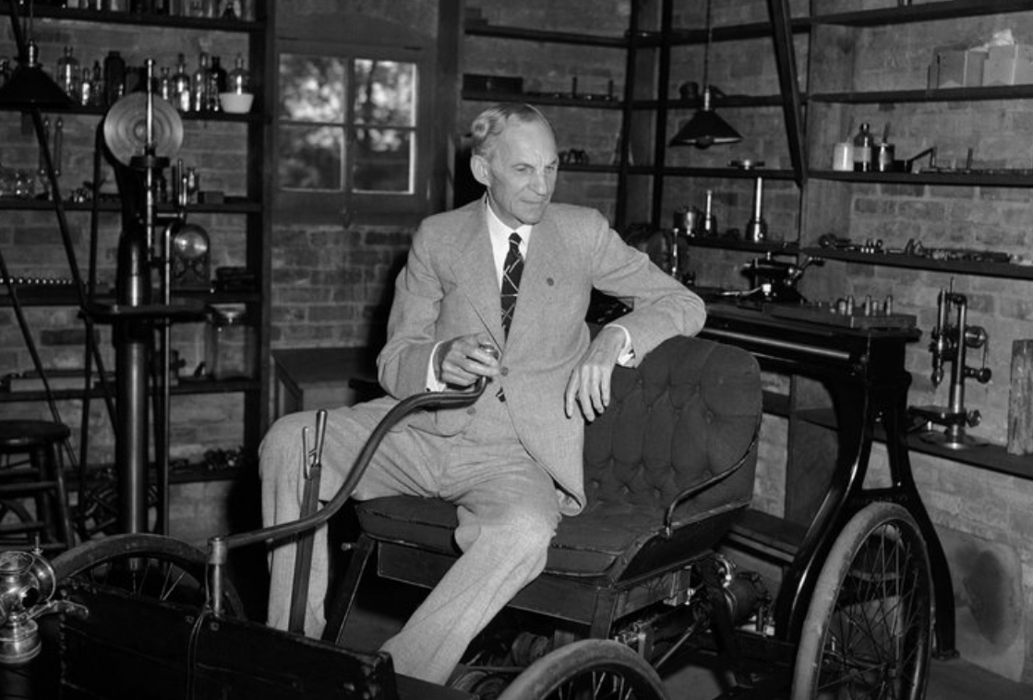
Mass Production is God

Slide 17
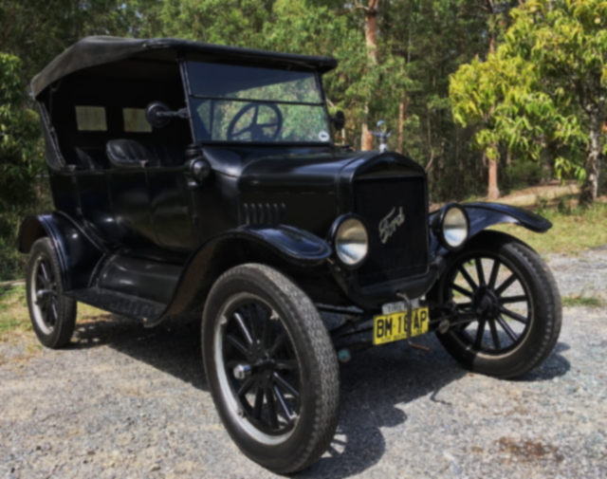
Mass Production is God
Focus on standardization.
Important are tools, not human.
There is very little competition between companies.
Production lines and automation.
The term “management” comes into play.

Slide 18

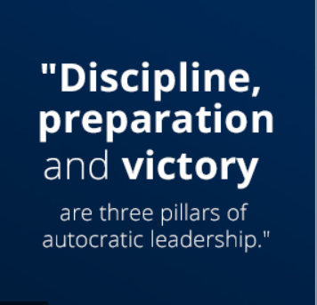
Management – the army style
WW1 and WW2 – change the environment.
The Authority is unquestionable.
Flow is “top to down”.
The style depends on personality.
There is no need to think, just obey.
The less you think, the more likely is to build up a solid career.
Even today most terms used in management are “taken” from military.

Slide 19
Kanban – a Lean Methodology
Developed by Toyota for lean manufacturing and just-in-time manufacturing.
Focus on improvement.
Visualize work.
A signal tells a supplier to produce and deliver a new shipment when a material is consumed.
Ohno is also known for his "Ten Precepts" to think and act to win.^{[7]}
You are a cost. First reduce waste.
First say, "I can do it." And try before everything.
The workplace is a teacher. You can find answers only in the workplace.
Notes:
Taiichi Ohno

Slide 20
Kanban – a Lean Methodology (2)
Do anything immediately. Starting something right now is the only way to win.
Once you start something, persevere with it. Do not give up until you finish it.
Explain difficult things in an easy-to-understand manner. Repeat things that are easy to understand.
Waste is hidden. Do not hide it. Make problems visible.
Valueless motions are equal to shortening one's life.
Re-improve what was improved for further improvement.
Wisdom is given equally to everybody. The point is whether one can exercise it.

Slide 21
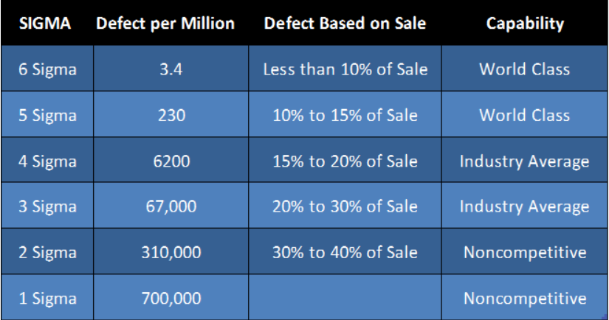
Lean Six Sigma
Evolving from Lean Methodology
Introduced by Motorola in 1978.
The Six Sigma Academy was formed and significantly advanced the tools and methods.
Lean techniques were integrated in Six Sigma.
99.99966% efficiency.
Notes:
Кey roles for its successful implementation
Executive Leadership includes the CEO and other members of top management.
Champions take responsibility for Six Sigma implementation across the organization in an integrated manner. The Executive Leadership draws them from upper management. Champions also act as mentors to Black Belts.
Master Black Belts, identified by Champions, act as in-house coaches on Six Sigma. They devote 100% of their time to Six Sigma. They assist Champions and guide Black Belts and Green Belts. Black Belts and Green Belts
Set of techniques and tools for process improvement. First introduced at Motorola around 1980.
99.99966% of all production should be defect free.
Continuous efforts to achieve stable and predictable process.
Manufacturing and business processes have characteristics that can be defined, measure, analyzed, improved, and controlled.
Achieving sustained quality improvement requires commitment from the entire organization.
An increased emphasis on strong and passionate management leadership and support.
A clear commitment to making decisions on the basis of verifiable data and statistical methods, rather than assumptions and guesswork.
Lean management and Six Sigma are two concepts which share similar methodologies and tools. Both programs are Japanese-influenced, but they are two different programs. \
Lean management is focused on eliminating waste using a set of proven standardized tools and methodologies that target organizational efficiencies while integrating a performance improvement system utilized by everyone, while Six Sigma's focus is on eliminating defects and reducing variation. Both systems are driven by data, though Six Sigma is much more dependent on accurate data.
100% - (3.4/1,000,000)% = 99.99966% 100% - (2/1,000,000,000)% = 99.9999998%

Slide 22
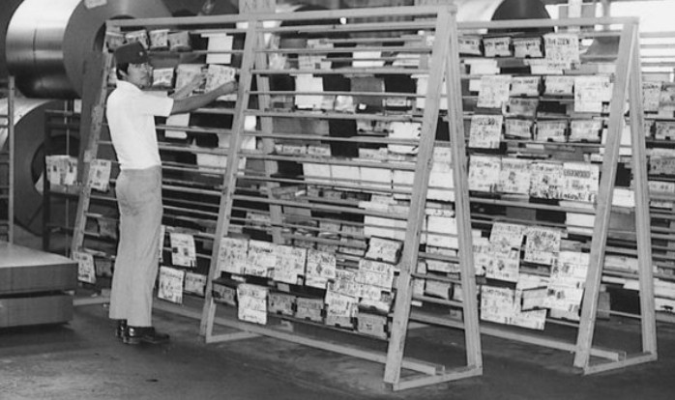
Kanban Board - original

Slide 23
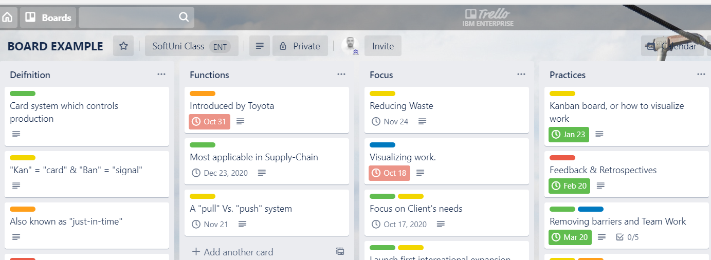
Kanban Board - today
Notes:
Somewhere in the 40-s. a scheduling system for lean manufacturing and just-in-time manufacturing (JIT).^{[2]} Taiichi Ohno, an industrial engineer at Toyota, developed kanban to improve manufacturing efficiency. Kanban is one method to achieve JIT.^{[3]} The system takes its name from the cards that track production within a factory. For many in the automotive sector, kanban is known as the "Toyota nameplate system" and as such the term is not used by some other automakers.

Slide 24


Slide 25
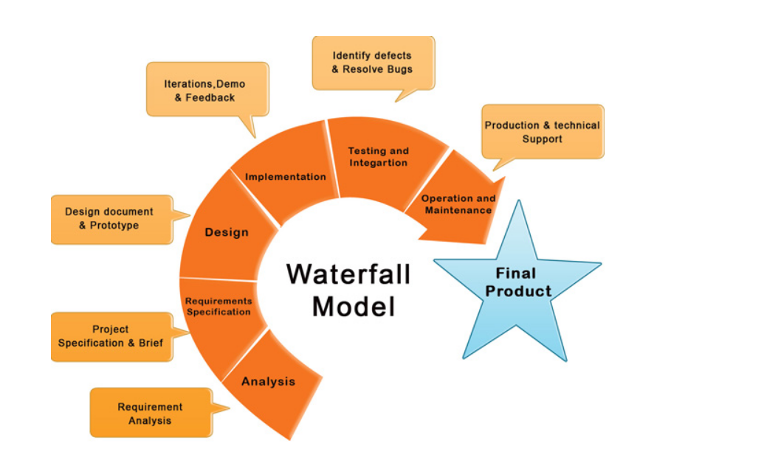
The waterfall (cascade) model
The “classic” project management model.
The project is a liner one. There are no iterations.
Each part of the project is an individual set of actions.
One starts when the previous is over
Original roots in production, engineering and construction. It is later adopted in SW development.
Widely used by large corporations, governmental projects.
Easy to manage, the deadlines are strict and set before a start of the project.
The product development is often slow, as most times the final product is somehow different from the initial expectations.
Notes:
Originates from a symposium on advanced programming held in 1956. Most suitable for construction and manufacturing.
The model requires that you move from one phase to another only once that phase has been successfully completed.
Widely used in large projects, the model consist of six parts, beginning with capturing requirements in a document, creating models to analyze them, designing, coding, testing and installing and maintenance of that system. Huge focus on documentation. Requirements and scope are fixed. The product is stable and well understood. Waterfall is great for manufacturing and construction projects, which are highly structured and when it’s too expensive to pivot or change anything after the fact. Waterfall often makes use of a Gantt chart for planning and scheduling; an example is below.

Slide 26
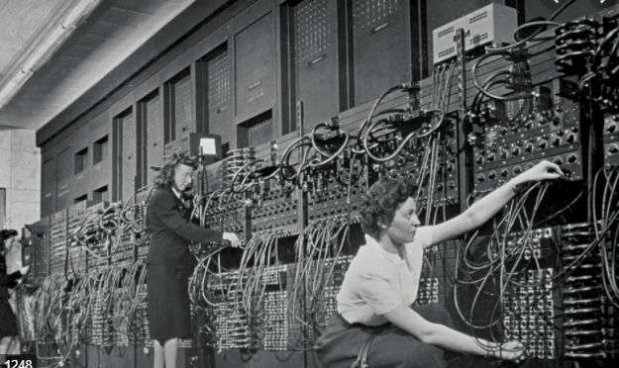
Waterfall is not all bad
Waterfall is not without sense.
Original code was written on paper.
The model seeks risk reduction through early planning.
Most projects were developed for large scale organizations.

Slide 27
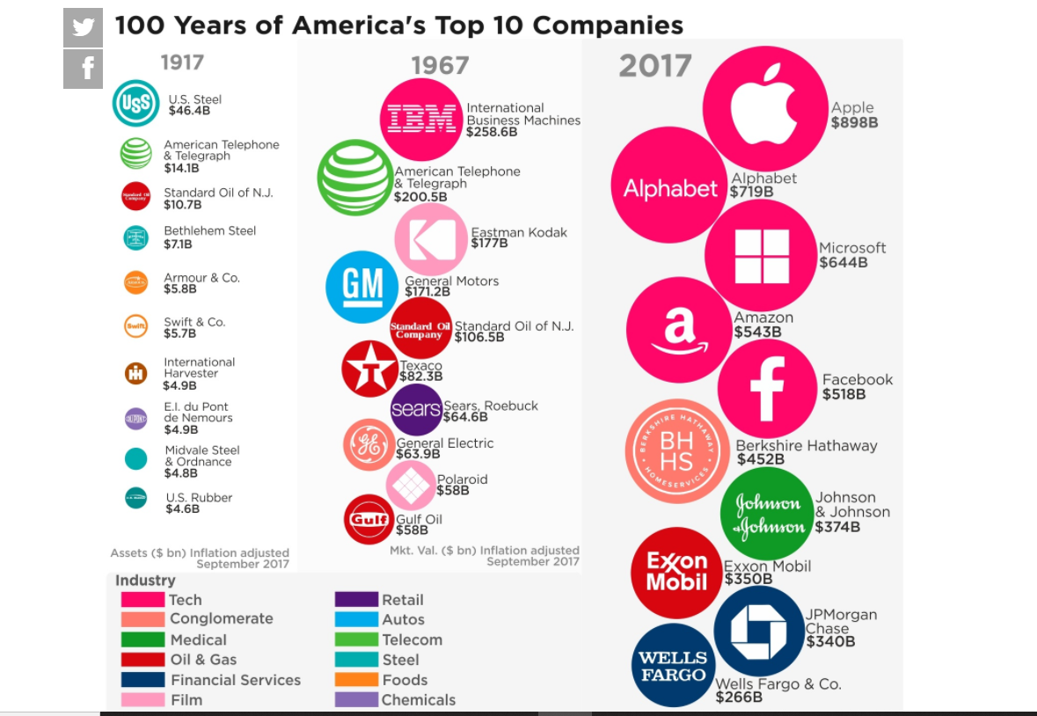
Internet and the dot.com Era

Slide 28
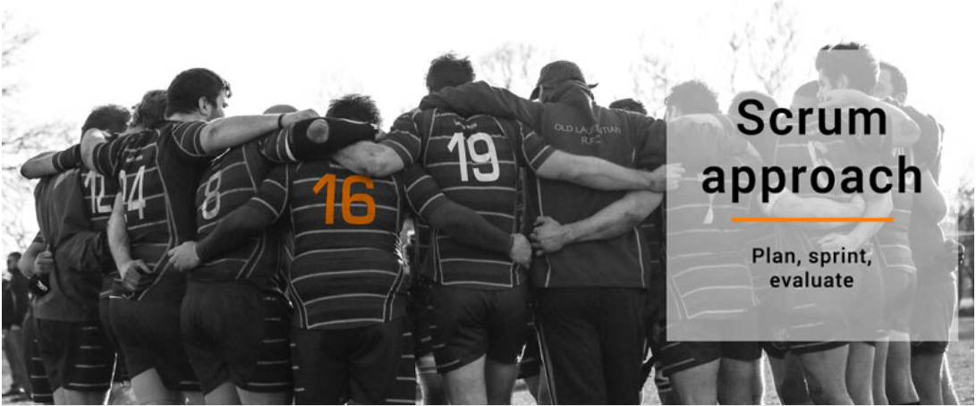
SCRUM, or do you like rugby?
Based on short cycles.
Typical cycle varies from 2 to 4 weeks.
After each cycle the team evaluates its strategy and adjust tactics.
It is almost a never ending circle which repeats.
At the end of the cycle there is always a workable product.
Notes:
Hirotaka Takeuchi and Ikujiro Nonaka introduced the term scrum in the context of product development in their 1986 Harvard Business Review article, 'The New New Product Development Game'.^{[11]} Takeuchi and Nonaka later argued in The Knowledge Creating Company^{[12]} that it is a form of "organizational knowledge creation, [...] especially good at bringing about innovation continuously, incrementally and spirally".

Slide 29
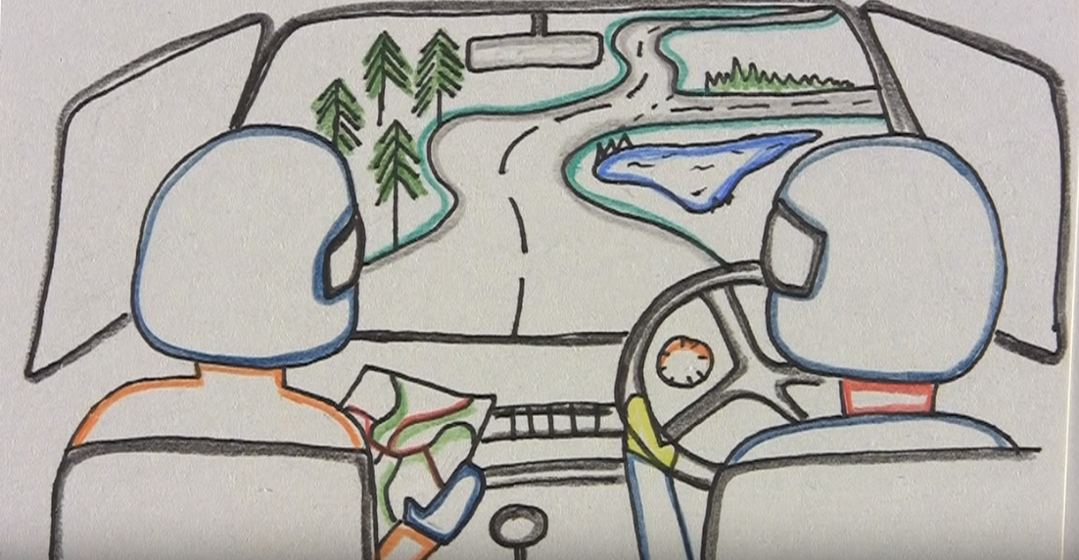
Crystal, XP, Pair Programming and others…

Slide 31
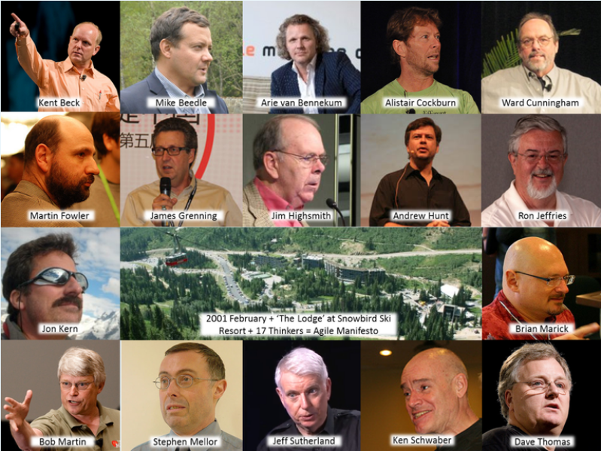
Agile Manifesto – 2001
Notes:
Scrum (Jeff Sutherland and Ken Schwaber – also Mike Beedle)
DSDM (DSDM Consortium represented by Arie van Bennekum)
ASD (Jim Highsmith)
XP (Kent Beck, Ward Cunningham and Ron Jeffries – Martin Fowler
Crystal was the starting point of the evolution of software development methodologies which ultimately resulted in what we know as agile movement. The honor of creating Crystal goes to Alistair Cockburn. The methodology was named “Crystal” only in 1997. Crystal can be applied to teams of up to 6 or 8 co-located developers working on systems that are not life-critical. You can see the seeds of agile manifesto in Crystal because it focuses on – (1) Frequent delivery of usable code to users, (2) Reflective improvement and (3) Osmotic communication preferably by being co-located.

Slide 32
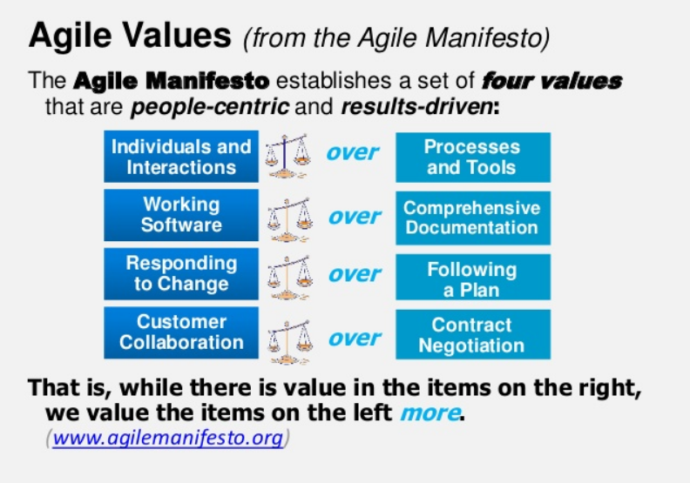
The Agile Manifesto

Slide 33
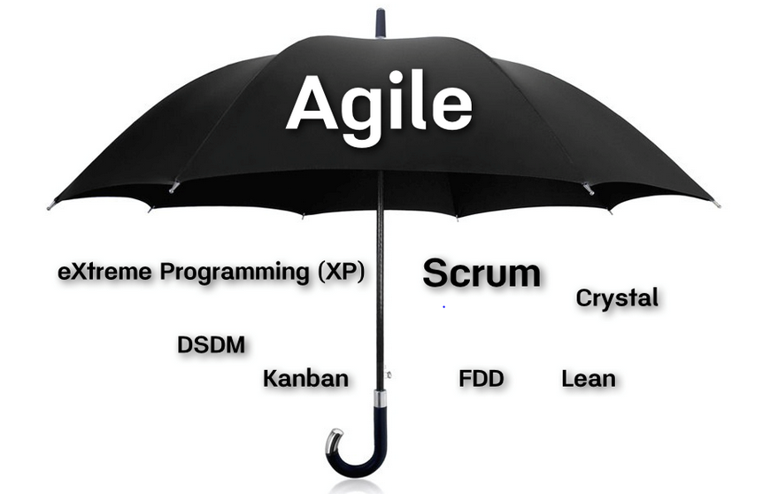
…so what do you think is Agile?
Notes:
Agile software development refers to a group of software development methodologies based on iterative development, where requirements and solutions evolve through collaboration between self-organizing cross-functional teams.
Agile methodology started with a focus on software development as a way of working that keeps everyone focused on quickly producing working software that meets customer needs, it generally promote a disciplined project management process that encourages frequent inspection and adaptation, a leadership philosophy that encourages teamwork, self-organization and accountability, a set of engineering best practices intended to allow for rapid delivery of high-quality software, and a business approach that aligns development with customer needs and company goals.

Slide 34
Definitions for Agile from business perspective
“Agile is a set of methods and frameworks that embody the principles and values of the “Agile Manifesto”.
“Agile is a term used to describe approaches to software development emphasizing incremental delivery, team collaboration, continual planning, and continual learning. The term “Agile” was coined in 2001 in the “Agile Manifesto”.
“Being ‘Agile Is a mindset. It’s about finding the right thing to build, faster (and not just building things faster)”

Slide 35
Definitions for Agile from business perspective (2)
“Agile is a time boxed, iterative approach to software delivery that builds software incrementally from the start of the project, instead of trying to deliver it all at once near the end.”
“The ability to create and respond to change in order to succeed in an uncertain and turbulent environment.”
“Agile is best suited for situations that have some level of uncertainty where creativity and innovation are important to maximize the business value of the solution as opposed to other situations with lower levels of uncertainty where planning and control to achieve predictability are more important.”

Slide 36
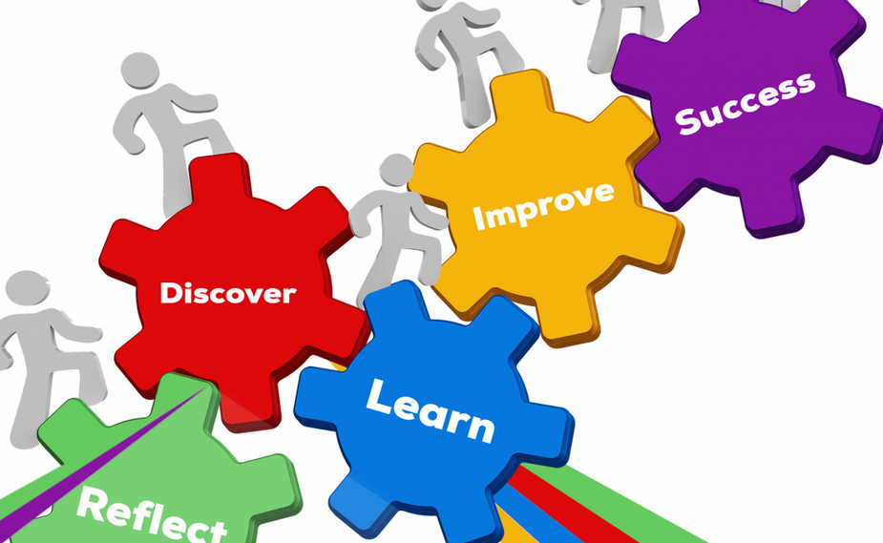
My view of Agile – a JIGSAW puzzle which needs to be solved.

Slide 37
…so what is Agile?
Daily Stand Ups
Hopes & Fears
Retrospectives, Showcase, Poker Planning, Automated Testing,
Wall of Work, Social Contract and many others.
Fail Early; Welcome Change; Working SW at the end of each cycle; Team Collaboration; Efficient Communication; Working SW is the only mean of success; Sustainability; Attention to technology; Simplicity; Speed; Self Sufficient Team.
Individuals and interactions over processes and tools Working software over comprehensive documentation Customer collaboration over contract negotiation Responding to change over following a plan
Practices
Principles
Values

Slide 38

Summary
Agile is a Mindset.
It is build on Values, Principles and Practices.
It is developed for SW development, but applicable outside of it.
It is developed by practitioners.
It was built on top of existing methodologies.
And it is still evolving.
Agile is NOT a project management methodology.
Agile is NOT an answer to every problem.
…
…
…

Slide 40













SoftUni Diamond Partners

Slide 41




SoftUni Organizational Partners

Slide 42





Trainings @ Software University (SoftUni)
Software University – High-Quality Education, Profession and Job for Software Developers
softuni.bg
Software University Foundation
http://softuni.foundation/
Software University @ Facebook
facebook.com/SoftwareUniversity
Software University Forums
forum.softuni.bg

